Slide 1
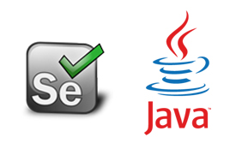
Automation Testing
By- Manas

Slide 2
SYNCHRONIZATION POINT
The time gap between tool and application is called synchronization point. During the execution if the application is taking more time to display the elements, tool can not be able to continue the execution. In that case we are giving instructions to tool to wait for some more extra time until the elements are available. These instructions we are providing to the tool in three different ways.
1. Java wait
2. Implicit wait
3. Explicit Wait/ WebDriver wait
4. Fluent Wait

Slide 3
Java Wait
We are using Java wait to stop the execution temporarily irrespective of the application.
We are using “thread. Sleep” for java wait in selenium.
Syntax: Thread.Sleep(time in milliseconds);

Slide 4
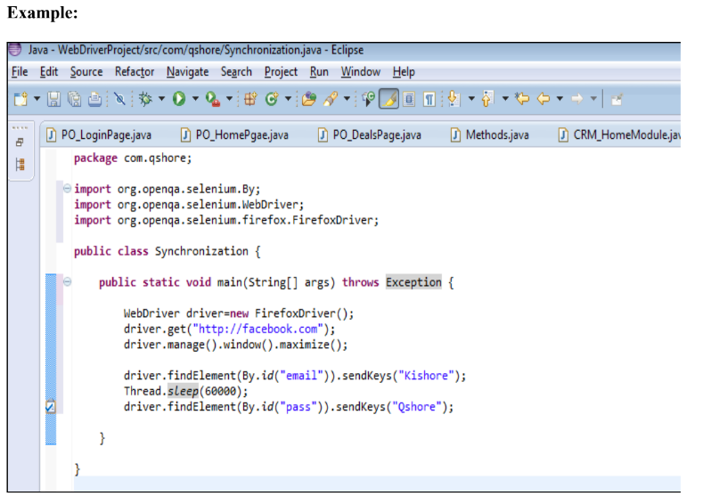
Note: In the above example tool will wait for 60 seconds after entering email even though password is available.

Slide 5
Implicit Wait
We are using implicit wait to stop the execution temporarily based on the availability of the element in application.
Syntax:
driver.manage().timeouts().implicitlywait(time, Timeunit.SECONDS);

Slide 6
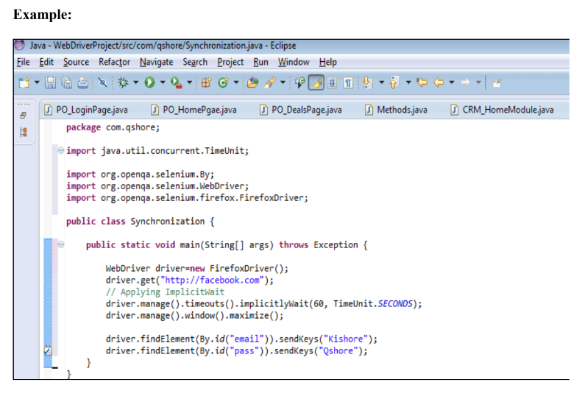

Slide 7
Webdriver Wait/Explicit Wait
We are using explicit /webdriver wait to stop the execution temporarily based on the behavior/availability of the element in application.
For working with webdriver wait we need to create the object of WebDriver wait class.

Slide 8
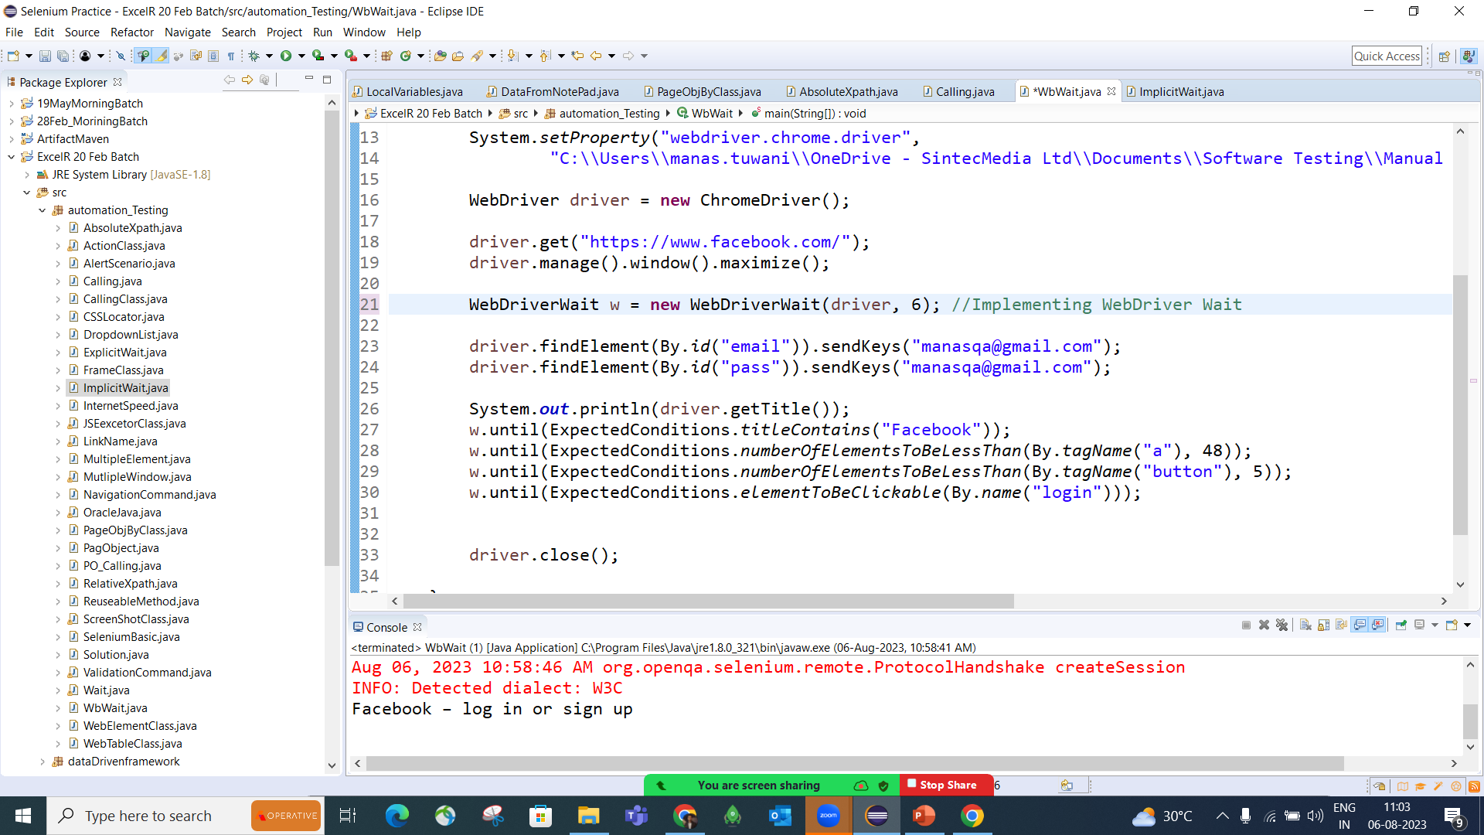

Slide 9
Fluent Wait
The Fluent Wait feature in Selenium WebDriver allows users to specify the maximum duration to wait for a particular condition.
During this time, WebDriver periodically checks if the condition has been satisfied(polling time).
It also allows ignoring specific exceptions while waiting, such as NoSuchElementException.
Syntax :
Wait<WebDriver> fluentWait = new FluentWait<>(driver)
.withTimeout(Duration.ofSeconds(10))
.pollingEvery(Duration.ofSeconds(2))
.ignoring(Exception.class);
Note : .withTimeout(Duration) – Total time to wait
.pollingEvery(Duration) – specific interval btw each check
.ignoring(Exception) – Handle exception during polling wait

Slide 10
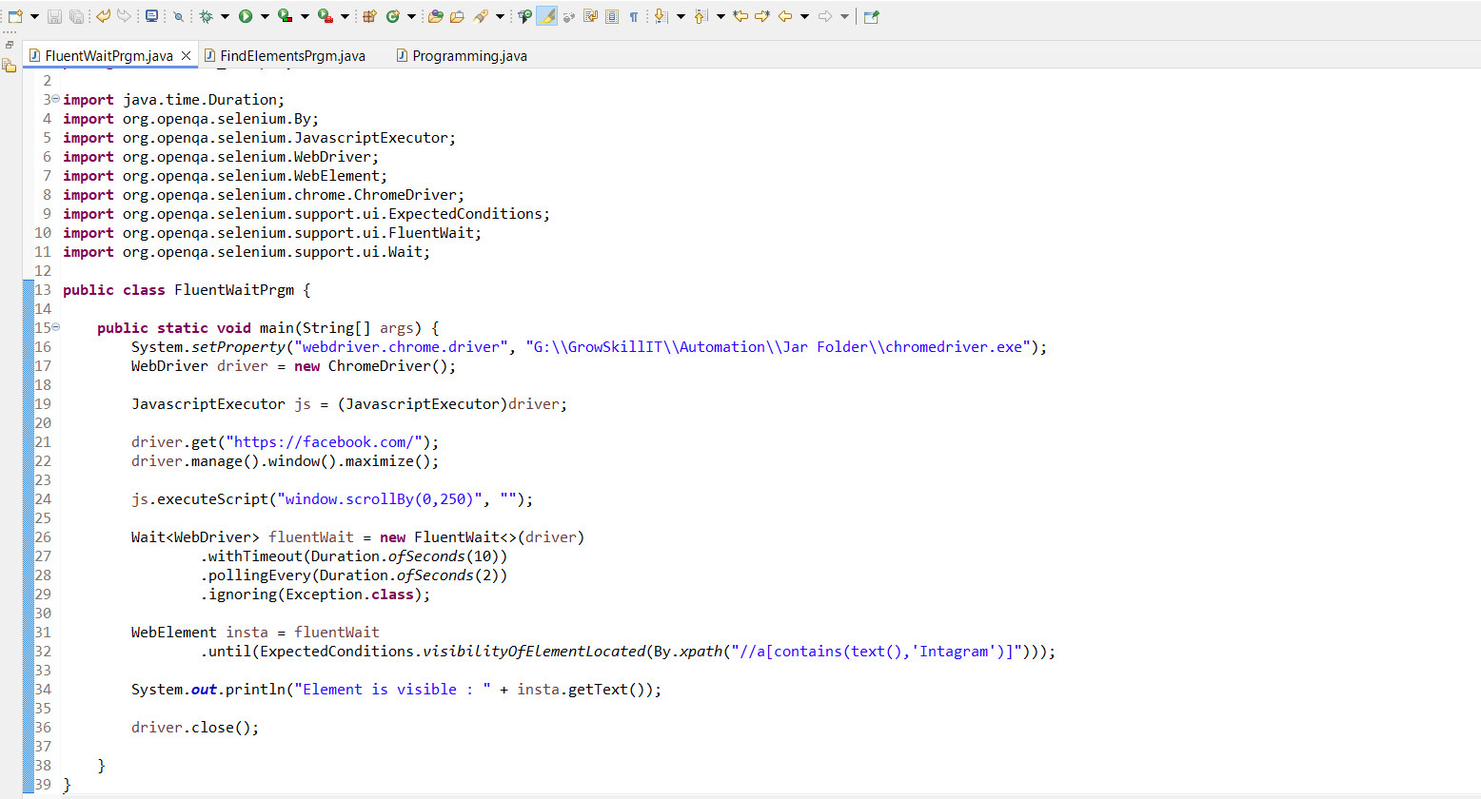

Slide 11
FAQ’s:
1. What is Synchronization Point?
2. What is implicitwait?
3. Difference between implicit and explicit wait?
4. What is WebdriverWait?
5. What is the syntax for WebDriverWait?
6. In which scenarios you are using WebdriverWait?
7. In which scenarios you are using implicit wait in projects?

